Slide 1

Sharing
Code
between
Blazor
WebAssembly
and
Blazor
Server
Daniel Villamizar
Senior Cloud Solutions Architect - MVP
@danielvillamizara – https://www.linkedin.com/in/danielvillamizara/

Slide 2


Module
overview
Introducing Blazor Server
A new architecture for maximized code-sharing

Slide 3
Introducing
Blazor
Server

Slide 4
Blazor
Hosting
Models
WebAssembly
Server

Slide 5


How
Blazor
WebAssembly
Works
Blazor app

Slide 6


How
Blazor
Server
Works
ASP.NET Core
Blazor app
SignalR

Slide 7


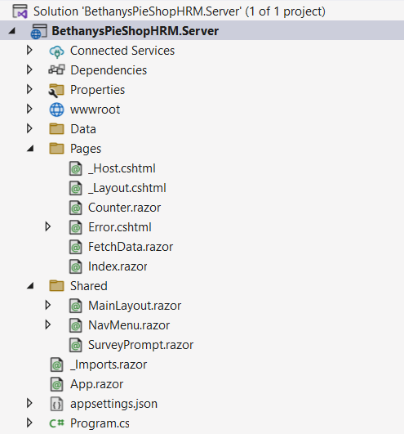
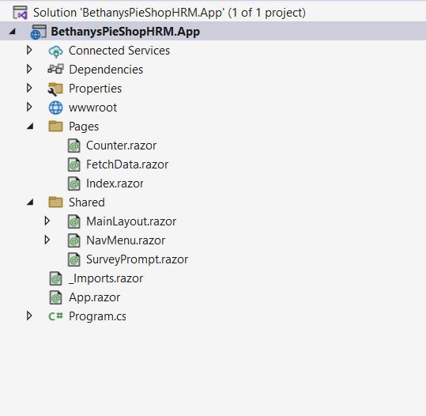
Comparing
Server-side
and
Client-side
Blazor

Slide 8
Invoking
Blazor
Server
Through
a
JS
file
<!DOCTYPE
html>
<html
lang="en">
<head>
<meta
...
</head>
<body>
charset="utf-8"
/>
@RenderBody()
<div
id="blazor-error-ui">
<environment
include="Staging,Production">
An
error
has
occurred.
This
application
may
no
longer
respond
until
reloaded.
</environment>
<environment
include="Development">
An
unhandled
exception
has
occurred.
See
browser
dev
tools
for
details.
</environment>
<a
<a
</div>
href=""
class="reload">Reload</a>
class="dismiss">🗙</a>
<script
</body>
</html>
src="_framework/blazor.server.js"></script>

Slide 9



The
Case
for
Blazor
Server
No initial download,
all code executes on server
All .NET Core server
features become available
Code
isn’t shared with
clients

Slide 10



But…
No offline support
Scalability
Network delay

Slide 11


Demo
Exploring File à New Project for
server-side Blazor

Slide 12
A
New
Architecture
for
Maximized
Code-sharing

Slide 13

Sharing code
-
-
App code is shared
We can call the “app” from a Blazor WASM or
Blazor Server project
Extract what’s different to the individual
projects
Share all the rest
-
-

Slide 14
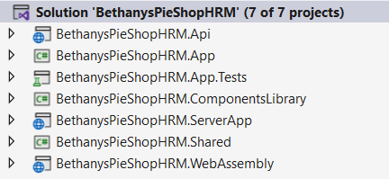
Proposed
Approach

Slide 15
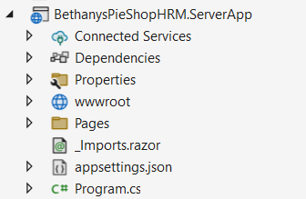
Blazor
Server
App

Slide 16
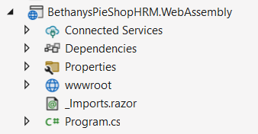
Blazor
WebAssembly
App

Slide 17
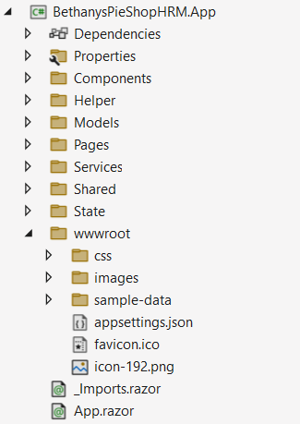
Shared project
-
-
-
index.html is removed
Project is a Razor Class Library
All code in here can be reused

Slide 18
Demo
Exploring the new architecture

Slide 19
Summary
Blazor code can be shared between WASM
and Server projects

Slide 20

Up
next:
Deploying
our
application
to
Azure

